Slide 1

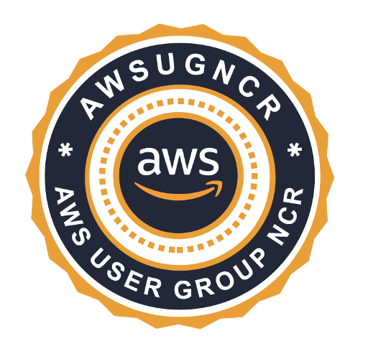
AWS Security Series
Part 1: AWS Security Fundamentals &
Audit Best Practices
Nitin Sharma
CyberSecurity and DevSecOps Engineer LinkedIn: linkedin.com/in/nitins87
Quora: quora.com/profile/NitinS-1
Blog: 4hathacker.in

Slide 2
Contents
$ whoami
$ AWS Shared Responsibility Model (Diagram and Explanation)
$ AWS Well Architected Framework (Pillars and Understanding)
$ AWS Security Pillar ( 5 areas of AWS Security )
$ AWS Security - Perspective and Services
$ AWS Security Auditing
$ Demo - AWS Security Audit with Prowler
Notes:
Note: Remove brackets once finalized.

Slide 3
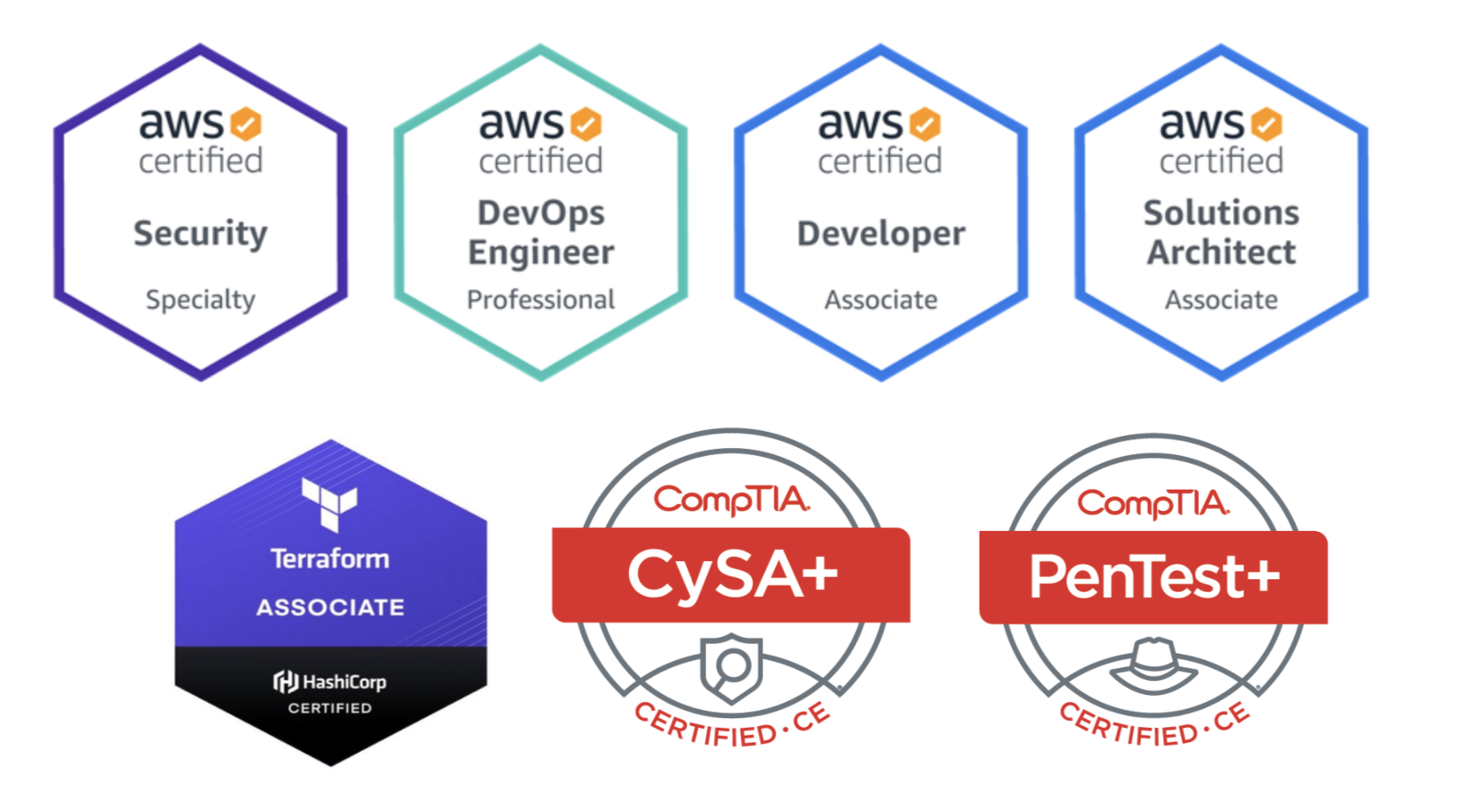
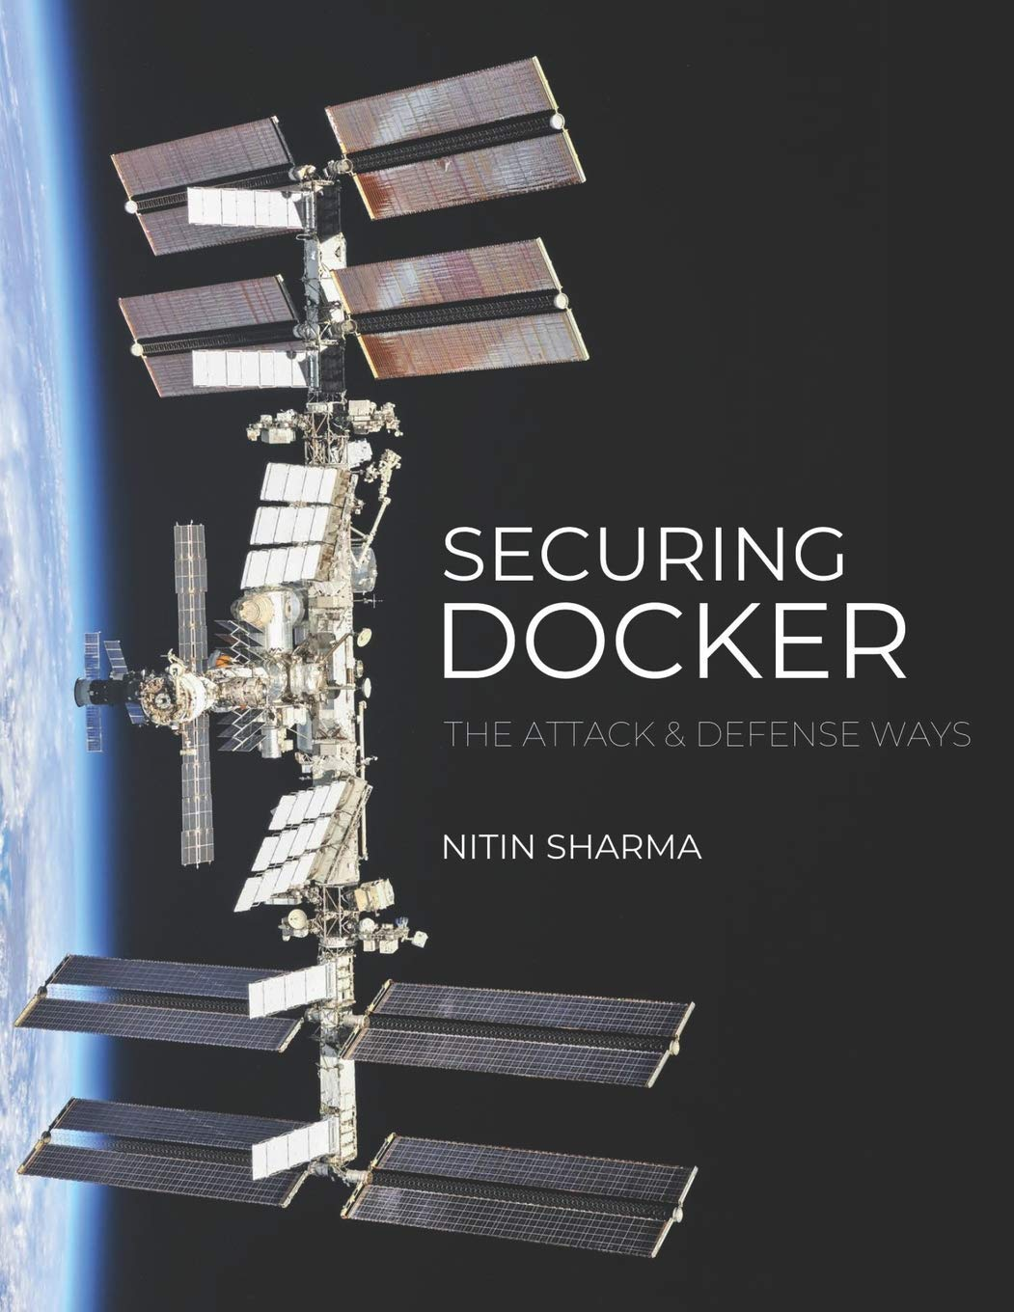
$ whoami
Cybersecurity and DevSecOps professional experienced in Cloud Security, Container Security and DevOps Research
Certifications:
Published author for “Securing Docker - The Attack & Defense Ways” book under CyberSecrets Publication
Half Marathon runner, Cyclist and Fitness Enthusiast
Helping out beginners in Cloud, DevOps and CyberSec at Quora

Slide 4
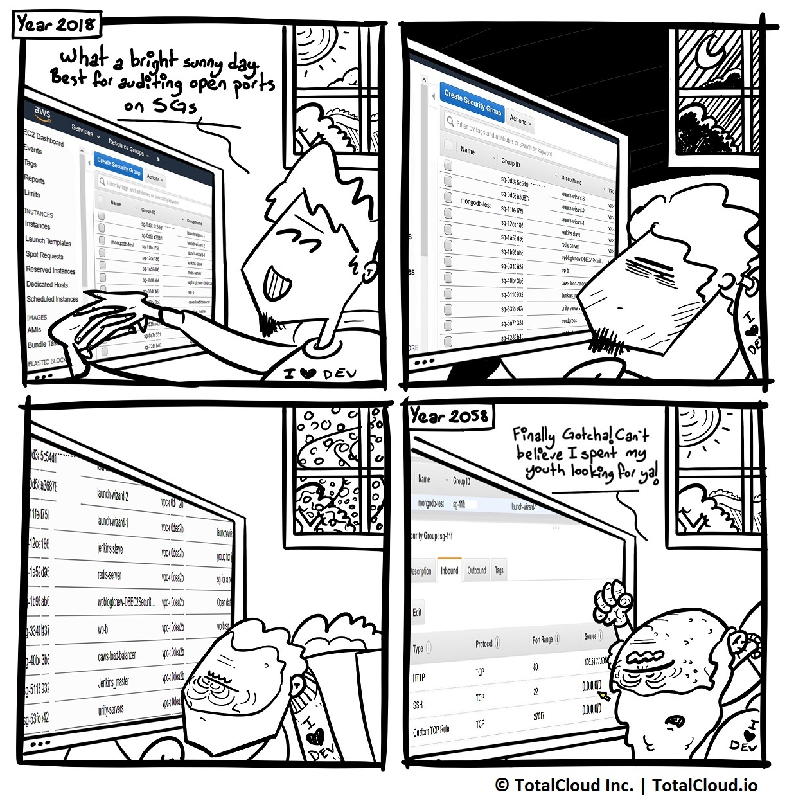
$ whoami (in the past…)
Notes:
Notes:
**Warning** - Rules with source 0.0.0.0/0 in Security Groups allows every IP address to access the instance. AWS recommends setting security group rules to allow access from known IP addresses only.

Slide 5
$ AWS Well Architected Framework
AWS Well Architected Framework
Operational
Excellence
Security
Reliability
Cost
Optimization
Performance
Efficiency
(Source: https://docs.aws.amazon.com/wellarchitected/latest/framework/wellarchitected-framework.pdf)
Notes:
Notes:
Operational Excellence: Organize, Prepare, Operate and Evolve. [To support and run AWS workloads effectively, gaining insights into the operations]
Security: IAM, Detection and Incident Response, Infra Protection and Data Protection. [The job zero where Security is everyone’s responsibility]
Reliability: Foundations, Workload Architecture, Change Management and Failure Management. [Consistency with Change & Failure Management along with other improvements]
Cost Optimization: Practice Cloud Financial Management, Expenditure and usage awareness, Cost-effective resources, Manage demand and supply resources and Optimize over time. [Helps in getting business value at the lowest price point]
Performance Efficiency: Selection, Review, Monitoring and TradeOffs. [Ability to use resources efficiently with change in demand and tech evolution]

Slide 6
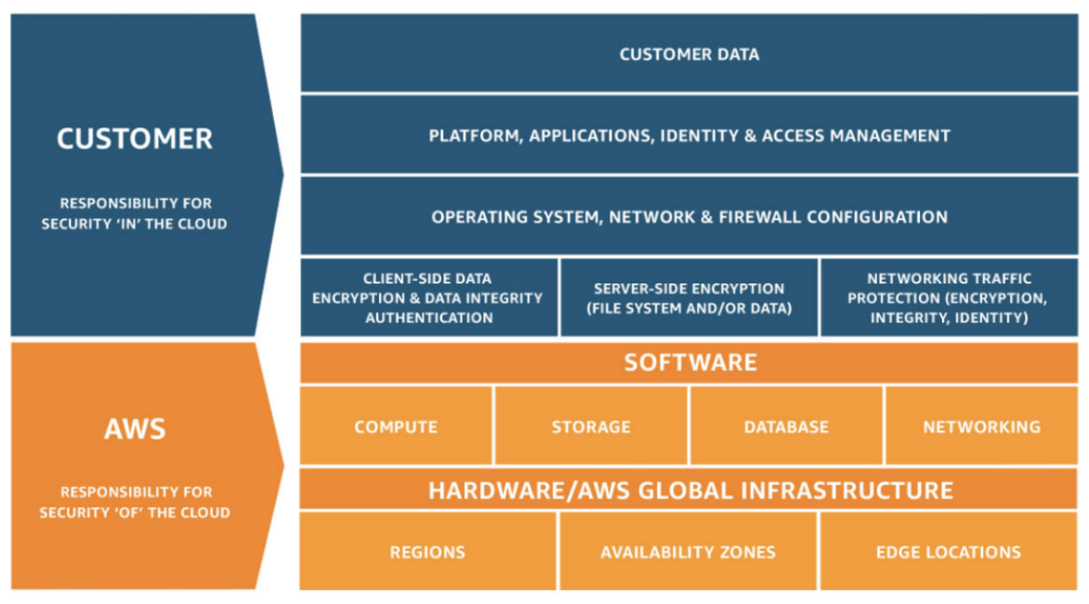
$ AWS Shared Responsibility Model
C S
C
C
S
P
Security ‘IN’ the Cloud v/s Security ‘OF’ the Cloud
(Source: https://aws.amazon.com/compliance/shared-responsibility-model/)
Notes:
Notes:
CSP’s Responsibility (AWS):
Physical Security, Virtualization Security, Environmental SafeGuards, Network Security, Administrative Controls, Certifications and Accreditations, etc.
CSC’s Responsibility (Customer):
Guest Operating System Security, Identity and Access Management, Application Security, Monitoring and Auditing, etc.

Slide 7
$ AWS - Security Pillar
“SECURITY PILLAR”
Identity & Access Management (IAM Users, Roles, Groups, etc.)
Detective Controls and Incident Response
Infrastructure Protection
Data Protection
Compliance
CSC
CSP
(Source: Security, Identity And Compliance in AWS)
Notes:
Notes:
Compliance is a shared responsibility between CSC and CSP.
Concept of Compliance Inheritance: A provider may have parts of their service certified as compliant which removes this from the audit scope of the customer, but the customer is still responsible for the compliance of everything they build on top of the provider.
List of AWS Services in Compliance: https://aws.amazon.com/compliance/services-in-scope/

Slide 8
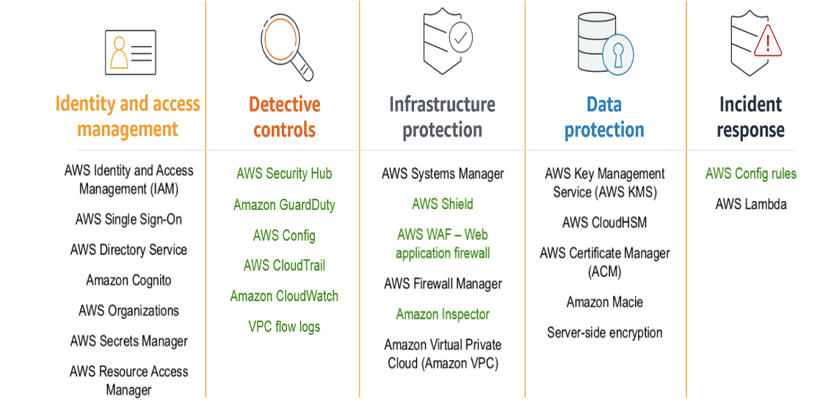
$ AWS Security - Perspective & Services
(Source: AWS CAF Security Perspective Capabilities)

Slide 9
$ AWS Security - Perspective & Services
CSPs are responsible for their cloud based infrastructure to be COMPLIANT.
CSCs are responsible for the COMPLIANCE of their own data, networks, applications, and operating systems that lives in the cloud.
Important Note:
Compliance (Act) ≠ Security (Objective)
Notes:
Notes:
Compliance does not necessarily imply that the organization is Secure.
Compliance can be a business enabler, a legal obligation and a contractual requirement.
There could be scenarios where an organization is,
Neither Compliant nor Secure.
Compliant but not Secure.
Secure but not Compliant.
Both Compliant and Secure.

Slide 10
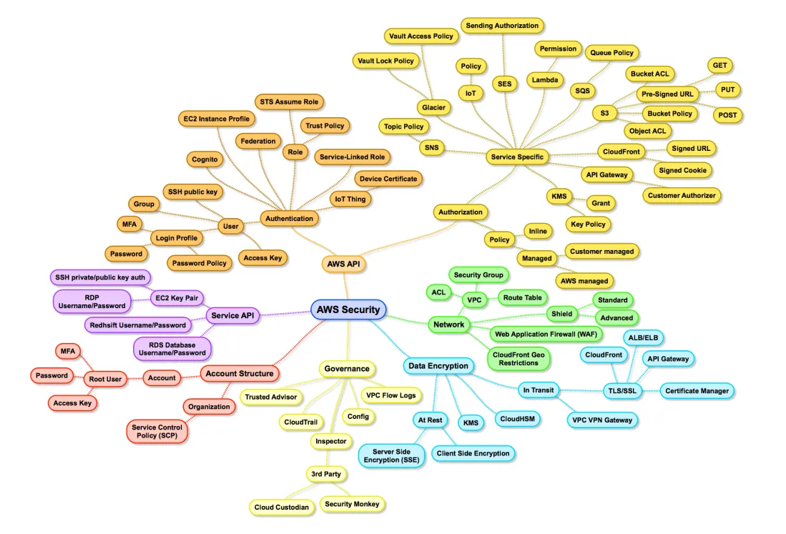
$ AWS Security - Perspective & Services
(Source: https://cloudonaut.io/images/2017/05/aws-security-surface.png)

Slide 11
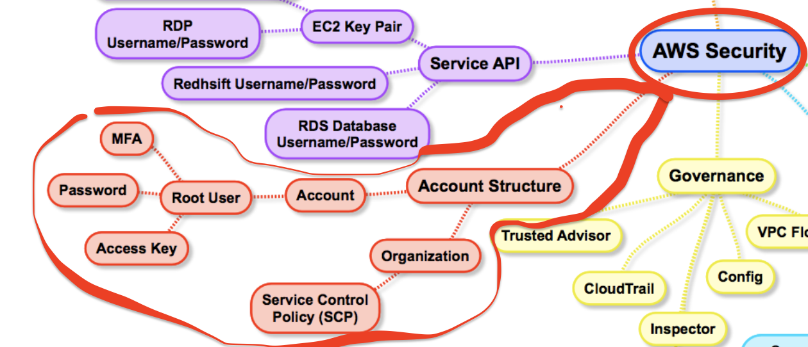
$ AWS Security - Perspective & Services
(Source: https://cloudonaut.io/images/2017/05/aws-security-surface.png)

Slide 12
$ AWS Security Auditing
A Cloud Security Audit refers to an independent examination of internal and external (cloud) processes as per the scope defined by applicable regulatory requirements and organisational policies, performed by a qualified personnel/assessor. This could be either Internal or External based on the objectives and expectations.
Important Note:
Audit = Proving (or Disproving) Compliance
Notes:
Audit is a mechanism to document compliance with internal or external requirements (or identify deficiencies).

Slide 13
$ AWS Security Auditing
Usually the assessment/examination is based on some control requirements.
E.g. Security Control XY(#N)
Ensure that there are no AWS IAM users with the administrator permissions (privileged users) in the AWS account while adhering to AWS IAM Security Best Practices.

Slide 14
$ AWS Security Auditing
Understand when that rule is said to be COMPLIANT,
No IAM users assigned with AWS Managed Policies that give them Administrator, Power User or Full Access to permissions to any AWS Service.
No IAM user assigned permissions to Create, Update or Delete all kind of AWS resources.

Slide 15
$ AWS Security Auditing
CIS Amazon Foundations Standard
Control 1.13 - Ensure MFA is enabled for the “root” account.
Payment Card Industry Data Security Standard (PCI DSS)
PCI.IAM.5 - Virtual MFA should be enabled for “root” user.

Slide 16
$ AWS Security Auditing
Tools of Trade,
Proprietary:
CheckPoint CloudGuard Dome9
CloudHealth by VMware
Open Source:
ScoutSuite
Prowler

Slide 17
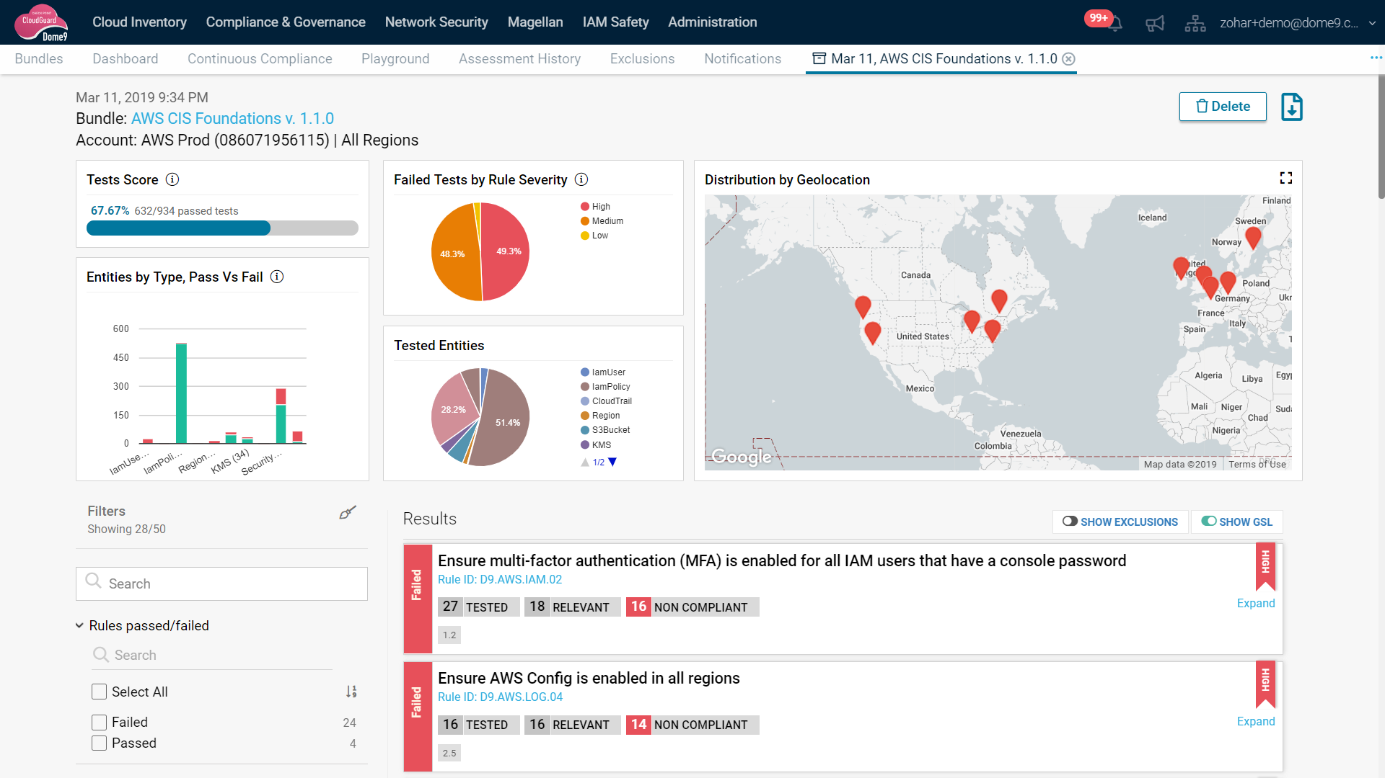
$ AWS Security Auditing
CheckPoint CloudGuard Dome9

Slide 18
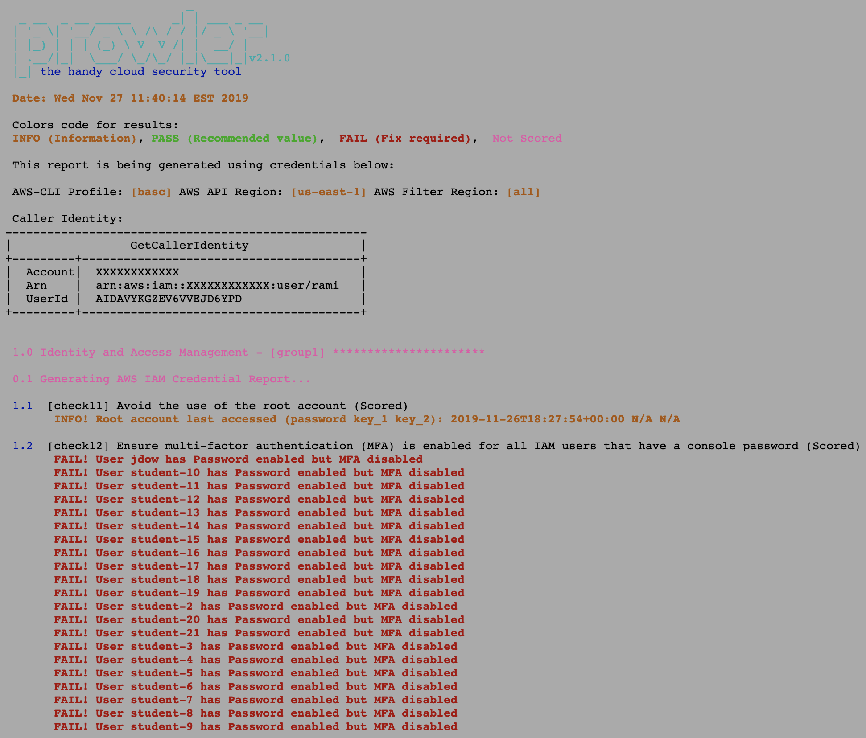
$ AWS Security Auditing
Prowler

Slide 19

$ Demo - AWS Security Audit with Prowler
Prowler (by Toni de la Fuente aka toniblyx) is a command line tool that helps you with AWS security assessment, auditing, hardening and incident response.
It follows guidelines of the CIS Amazon Web Services Foundations Benchmark (49 checks) and has more than 100 additional checks including related to GDPR, HIPAA, PCI-DSS, ISO-27001, FFIEC, SOC2 and others.

Slide 20
$ Demo - AWS Security Audit with Prowler
Demo Time...e

Slide 21
$ AWS Security Audit - Cloud Audit Academy
Cloud Audit Academy (CAA) is an Amazon Web Services (AWS) Security Auditing Free Digital Training and Learning Path designed for those that are in auditing, risk, and compliance roles and are involved in assessing regulated workloads in the cloud. (Announced in June 2017) Link: https://aws.amazon.com/compliance/auditor-learning-path/

Slide 22
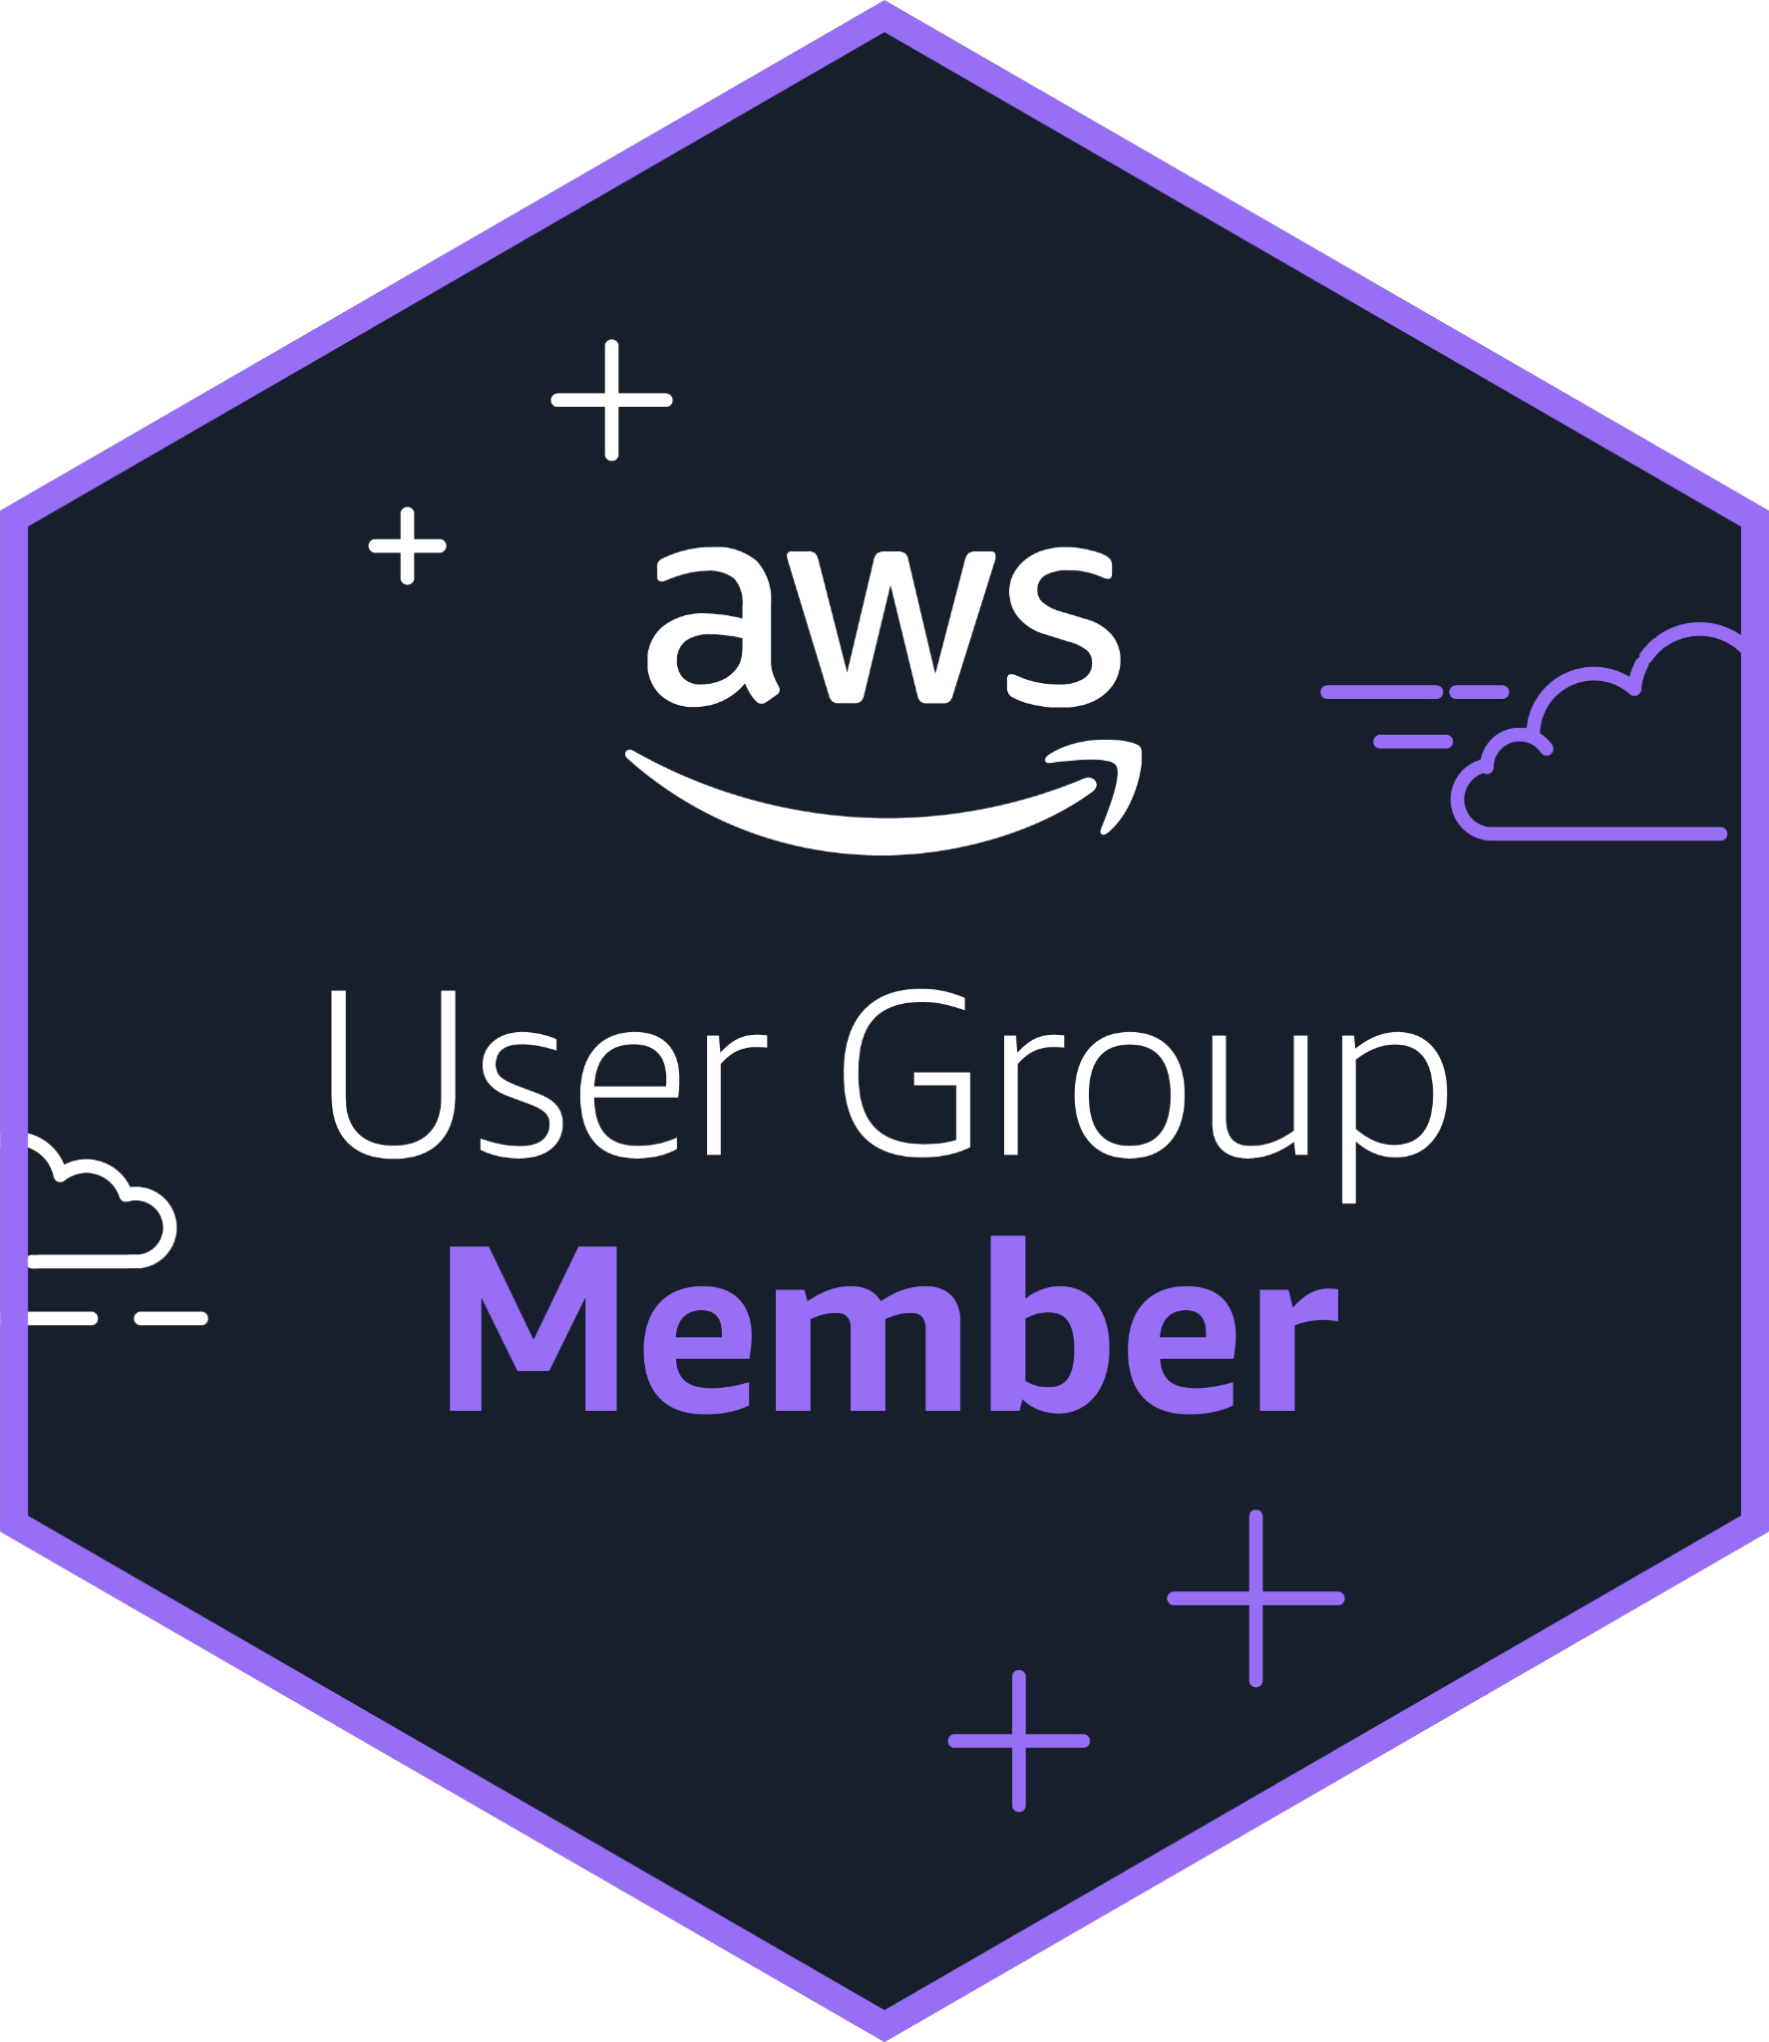
Thank You...
For queries feel free to connect with AWS Delhi User Group at:
AWS Delhi User Group (Meet-Up) - Learn Together, Grow Together
AWS User Group Delhi NCR (Follow us on LinkedIn Page)

